Slide 1

Health App with NLP for Calorie Tracking
Presented By
Suyash Tripathi 2100520100159
Harsh Vardhan 2100520100129
Vivek Kumar 2100520100163
Under the guidance of
Dr. Natthan Singh
Er. Sandeep Yadav

Slide 2
Intro to Natural Language Processing (NLP)
Language Understanding
Contextual Analysis
NLP allows computers to understand and interpret human language, unlocking new possibilities for interaction.
NLP techniques can analyze the context and meaning behind words and phrases, enabling accurate data extraction.

Slide 3
User's Natural Language Queries for Eating
Food Log
Calorie Estimates
Users can easily track their food intake by entering natural language descriptions such as "I had a bowl of oatmeal with berries" or "one slice of pizza with pepperoni."
The app can estimate the calorie content of meals and snacks based on the user's descriptions, eliminating manual calculations.

Slide 4



User's Natural Language Queries for Exercise
Workout Tracking
Calorie Burn Estimates
Users can input workouts using natural language like "30-minute run" or "1 hour yoga session," allowing for flexibility and ease of tracking.
The app can estimate the calorie burn based on the user's descriptions and activity levels, providing accurate insights.

Slide 5
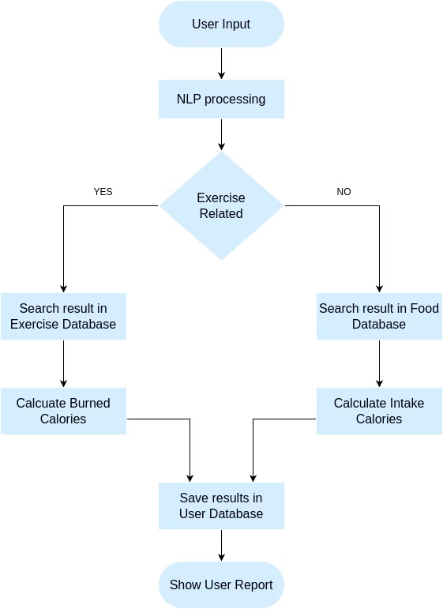
Methodology Overview
The methodology behind our calorie tracking app, which uses natural language processing (NLP) to analyze user inputs and provides personalized reports.

Slide 6
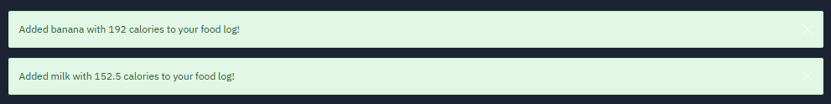
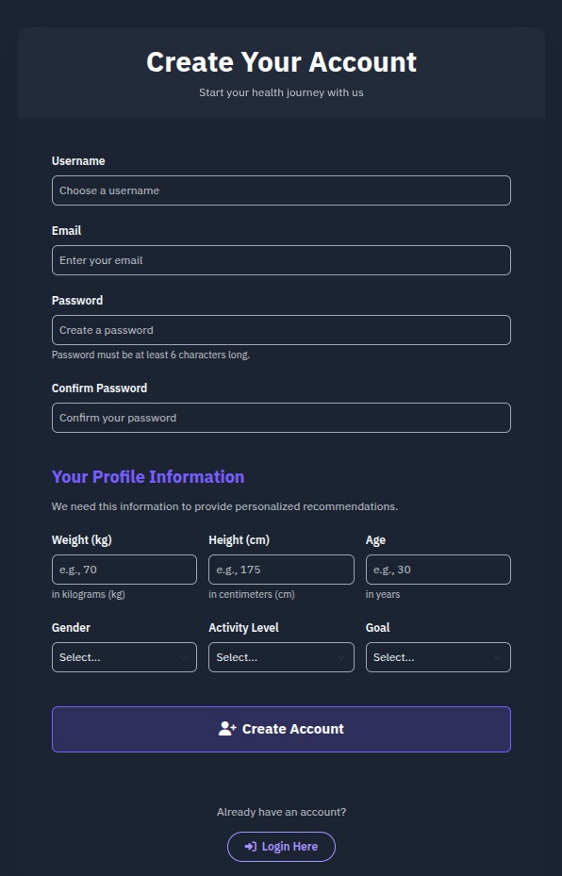
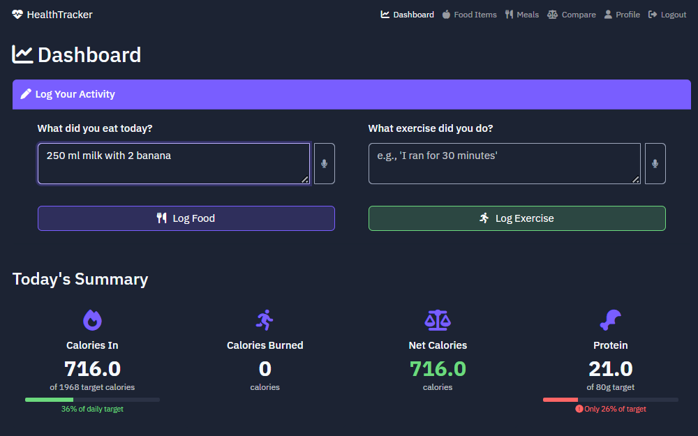

Slide 7
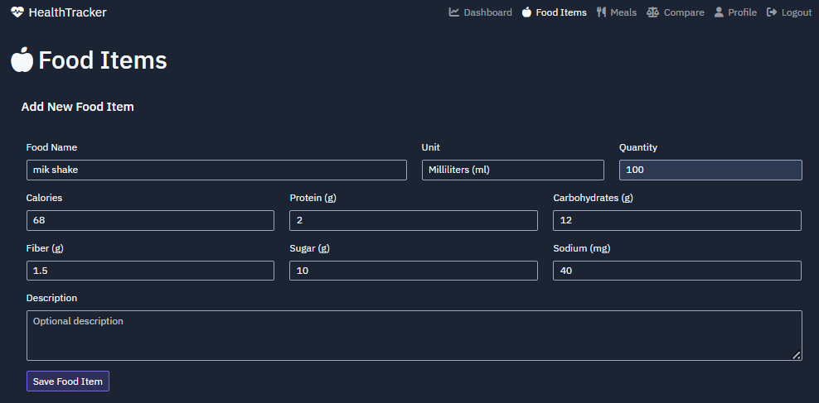
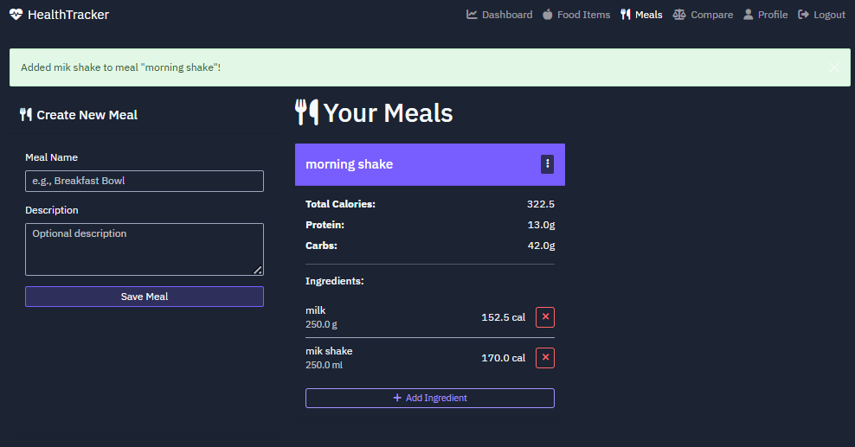

Slide 8
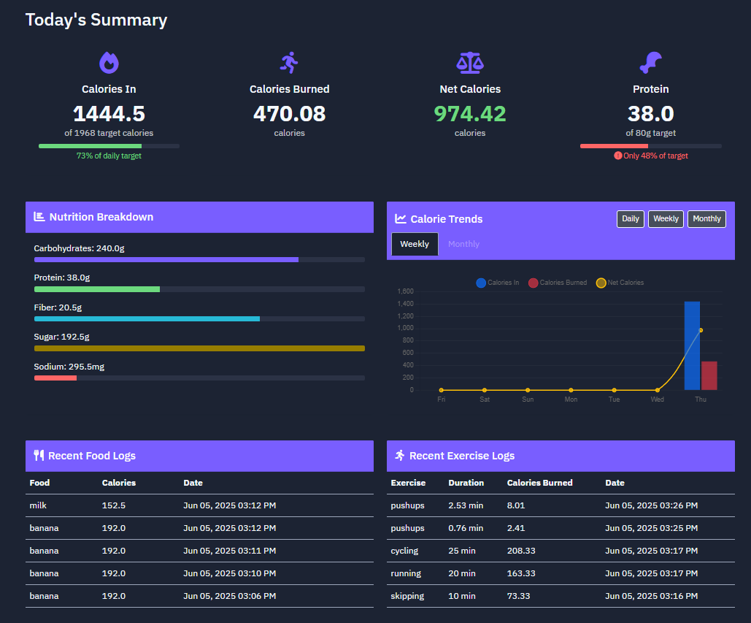

Slide 9
Methodology Overview
User Input
Data Processing
Calorie Calculation
Reporting
Users enter their food intake and exercise activities in a natural language format.
The input is processed using NLP models to extract relevant data points.
A calorie calculation engine uses the extracted data to estimate the user's calorie intake and expenditure.
The system generates reports and insights on the user's daily calorie intake and activity levels.

Slide 10
Methodology: NLP Processing
Query Interpretation
Named Entity Recognition (NER)
Tokenization
Using NLP models to understand user queries and extract relevant information.
Breaking down user input into individual tokens for further processing and analysis.
Identifying and extracting important entities, such as food names, exercise types and quantities.

Slide 11





Calorie Calculation
Food Matching
Matching user-entered food items to the database to retrieve their corresponding calorie values.
Exercise Matching
Matching user-entered exercise activities to the database to retrieve their calorie expenditure.
Algorithms
Using algorithms to accurately calculate the user's total calorie intake and expenditure.

Slide 12

Analyzing Daily, Weekly, and Monthly Reports
Daily Reports
Monthly Reports
Users can view daily summaries of their calorie intake and burn, allowing for immediate feedback and adjustments.
Monthly reports offer a long-term perspective, allowing users to track progress toward their health goals over time.
1
2
3
Weekly Reports
Weekly reports provide a comprehensive overview of dietary and exercise patterns, helping users identify trends and areas for improvement.

Slide 13




Helping Users Meet Their Health Goals
1
Weight Management
2
Improved Nutrition
3
Increased Activity
4
Enhanced Well-being

Slide 14

Conclusion
This NLP-powered health app has the potential to revolutionize calorie tracking and empower users to achieve their health goals.

Slide 15
Thank you

